Slide 1
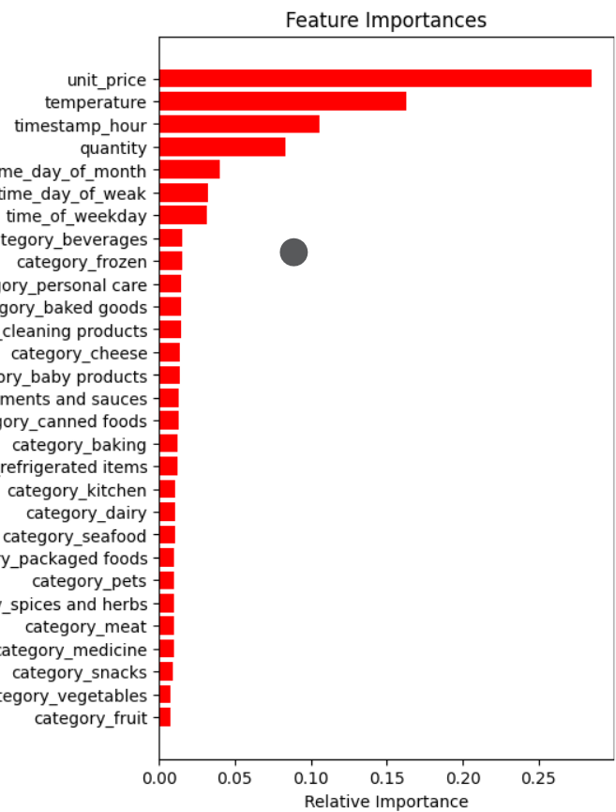
Key Insights from Inventory Prediction Model
Feature Importance Visualization:
Visual representation of feature importance from the model
Summary:
Product categories were found to have minimal impact on inventory stocking decisions.
Unit price and temperature emerged as significant factors influencing inventory levels.
Time of day was also identified as an important predictor of inventory needs.
Business Impact:
These insights enable informed decisions on inventory management and stocking strategies.
Adjusting pricing strateges and considering external factors like temperature can enhance inventory forecasting accuracy.
Aligning staffing levels and operations with peak hours identified by the model can improve efficiency and customer satisfaction.

Slide 2
